Slide 1


SMART INDIA HACKATHON 2024
TITLE PAGE
Problem Statement ID- SIH1761
Problem Statement Title- AI based Customized time slot Delivery of Articles/Parcels "To align with the needs of the modern lifestyles of customers and their expected time of availability at the home or office address where an item needs to be delivered, the time slot can be decided in consultation with the customer based on an AI Driven correspondence system as per demand/request of the Sender or Receiver"
Theme- Transportation & Logistics
PS Category- Software
Team ID- 6137
Team Name- Infinitely Innov@tive

Slide 2
OptiDeliver - Smart AI Delivery Scheduler
Infinitely Innov@tive
Problem:
To develop an AI system for India Post that predicts and optimizes delivery time slots for increased efficiency and customer satisfaction
How we are solving it:
Data Driven AI Approach: Our AI analyzes historical delivery data and recipient preferences, to accurately predict and suggest the most suitable delivery times
Uniqueness of the Solution:
AI-Driven Learning: The AI system continuously improves its scheduling by analyzing previous time slot selections and real time data making future deliveries more accurate and convenient.
User-Centric Design: The system provides both senders and recipients with the flexibility to modify delivery times, catering to their specific needs and reducing delivery failures.

Slide 3
GROUND RESEARCH
Infinitely Innov@tive
Survey:
Conducted a Google Form survey to gather insights on customer preferences and challenges, enhancing our understanding of public needs in delivery services
Local post office:
Visited a local post office to observe operational processes and identify key challenges.
Identified the potential for implementing an AI-driven system to improve parcel segregation, optimize delivery routes, and modernize the manual scanning process, ultimately enhancing the overall delivery workflow.
Literature Review:
Reviewed academic papers and industry articles to benchmark against existing last-mile delivery solutions, identifying gaps and opportunities for innovation in our approach.

Slide 4
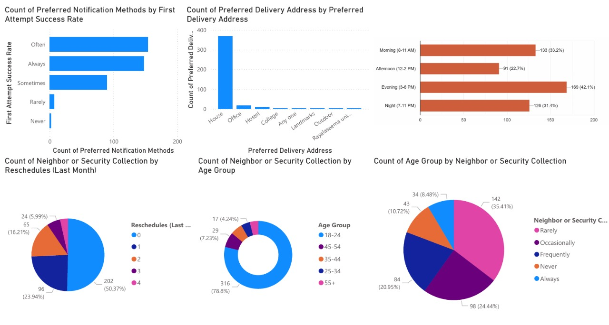
GROUND RESEARCH
Infinitely Innov@tive
Survey Insights

Slide 5
TECHNICAL APPROACH
Infinitely Innov@tive
Technology Stack
Frontend: React.js
Backend: NodeJS
Database: MongoDB
Notification System: Twilio – Sends real-time SMS/WhatsApp alerts to senders and recipients, allowing flexible delivery slot updates.
AI Slot Scheduling: Decision trees to predict the most preferable/convenient time slot for the receiver
Parcel Scheduling: K Means++ Clustering to cluster deliveries and assign them to postmen.
Reinforcement Learning: Q-Learning to enhance scheduling by learning from past deliveries and real-time feedback.
Model Retraining: The AI system is periodically retrained with new data, ensuring adaptability to changing user preferences and improving delivery accuracy over time.
Route Optimization: Open Service route API & Google Maps API ensure optimal delivery routes, reducing travel time and improving efficiency.

Slide 6
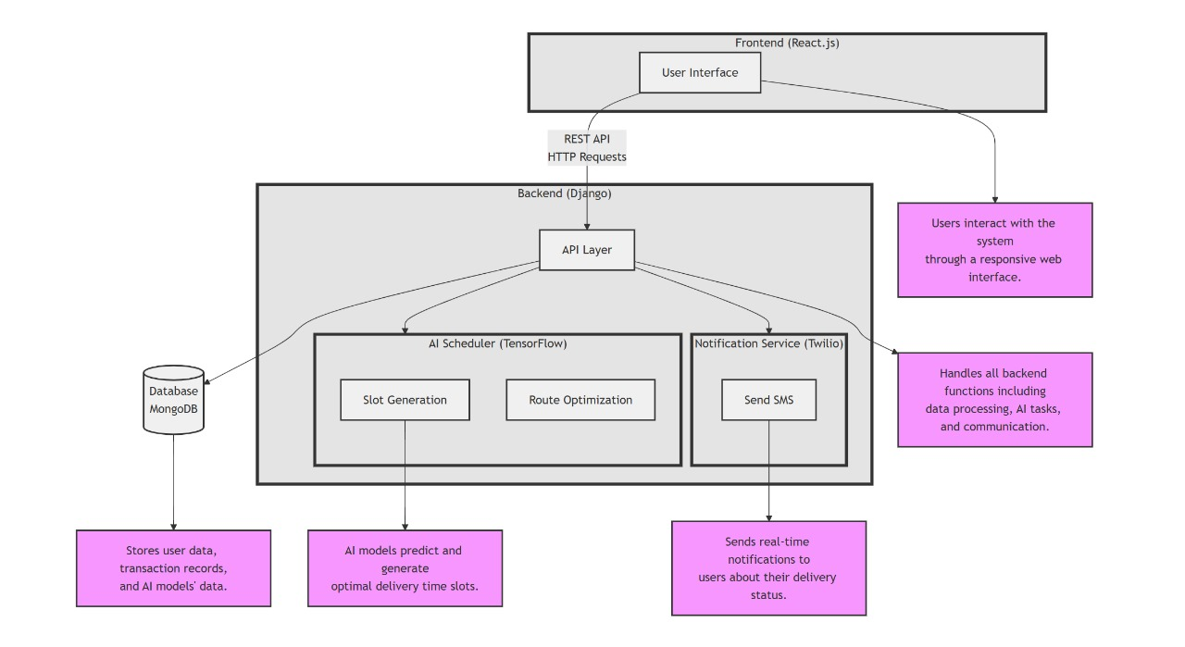


ARCHITECTURE
Infinitely Innov@tive

Slide 7
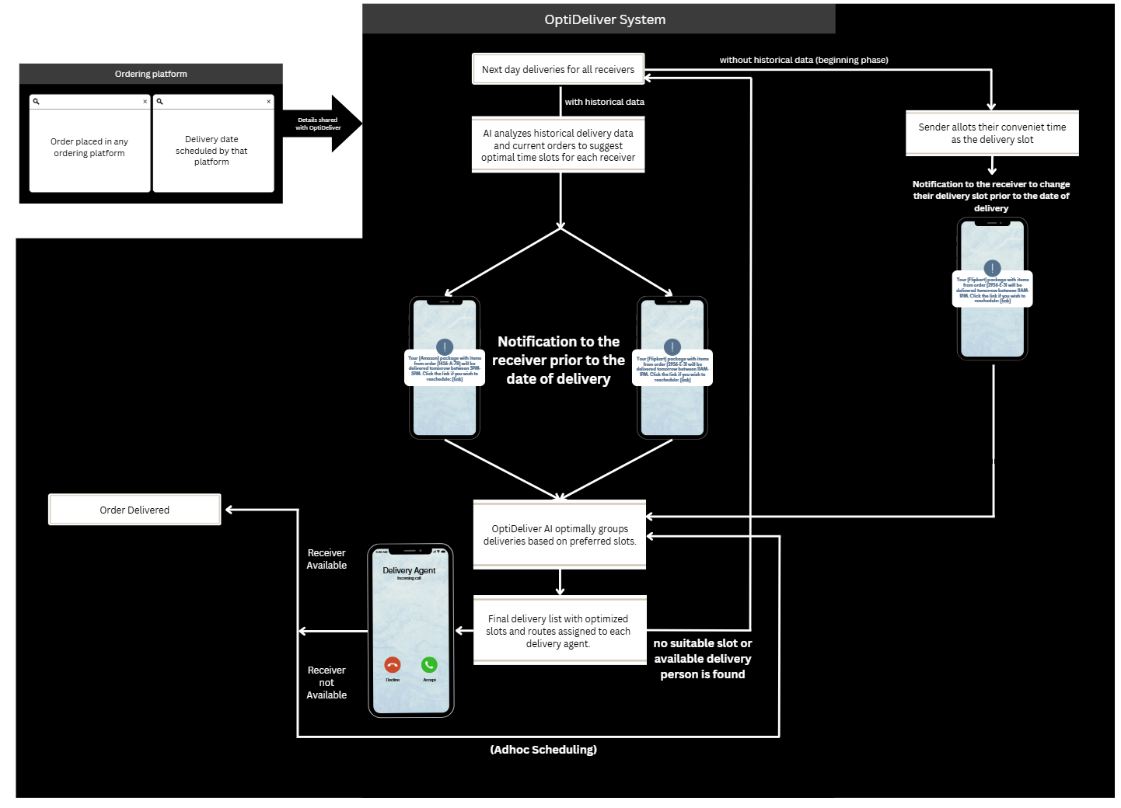
FLOW OF OUR SYSTEM
Infinitely Innov@tive

Slide 8
FEATURES
Infinitely Innov@tive
Sender’s Dashboard: Comprehensive Control - View, schedule, and modify deliveries with ease. Provides real-time updates on delivery status and flexible scheduling options.
Notification System: Sends timely notifications via SMS or WhatsApp, detailing the scheduled delivery slot and offering a direct link for convenient rescheduling up to the day before delivery.
Slot Prediction: AI-Driven Optimization - Utilizes advanced algorithms to predict the most convenient delivery slots for each customer, enhancing satisfaction and efficiency.
Clustering Deliveries: Employs K-means++ clustering to smartly group deliveries and assign them to delivery personnel, optimizing operational workflows.
Route Optimization: Dynamic Routing - Integrates Google Maps API to calculate the most efficient routes for each delivery person, reducing travel time and costs.
Mobile Application for Delivery Personnel: Real-Time Tracking - Enables delivery personnel to access their delivery schedules on-the-go, track package statuses, and navigate optimized routes.
Feedback Mechanism: Customer Insights - After delivery, customers can scan a QR code on the parcel or receive one via SMS to rate their delivery experience, providing valuable feedback to further refine the delivery process.

Slide 9
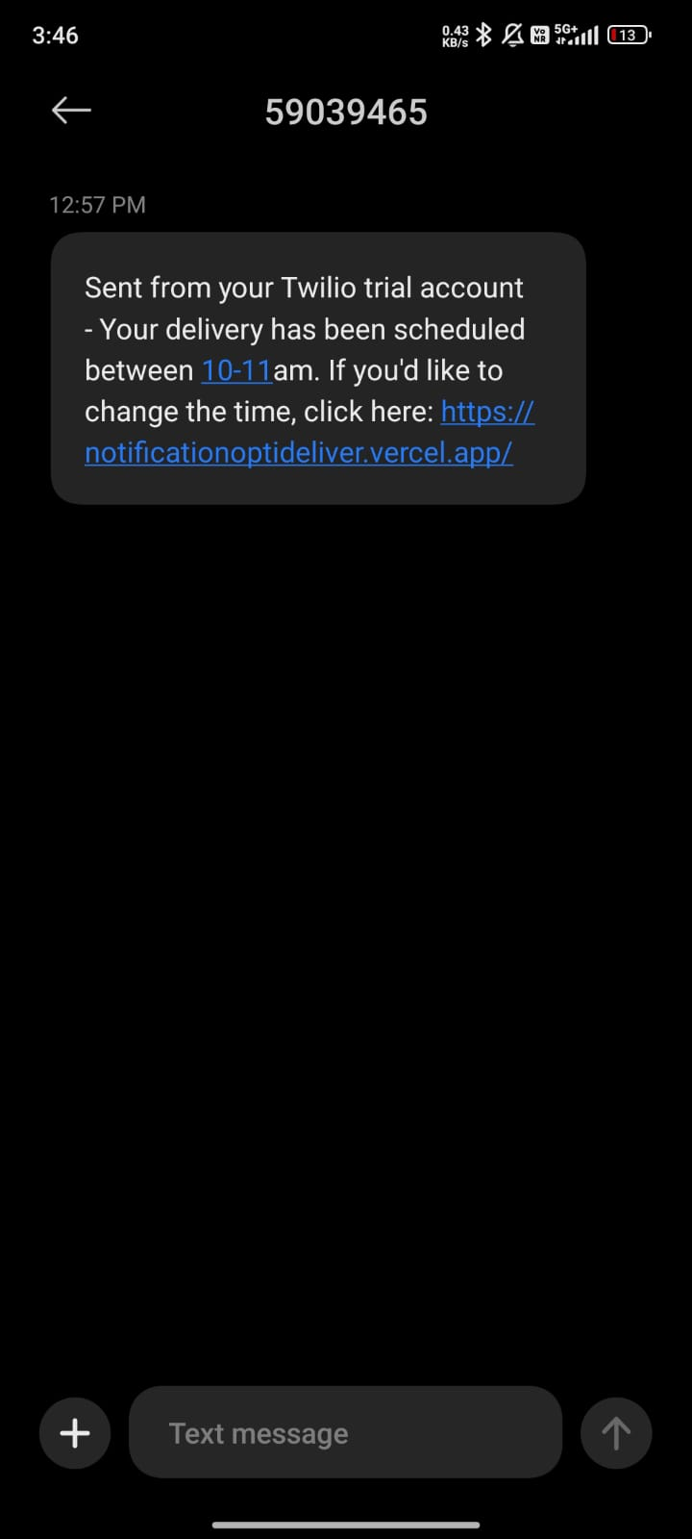
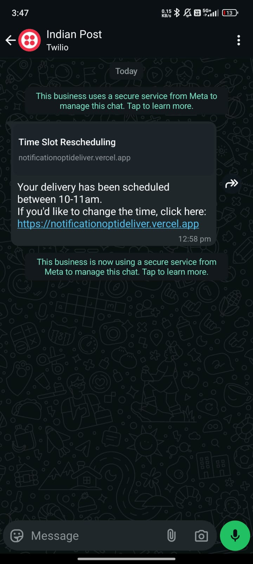
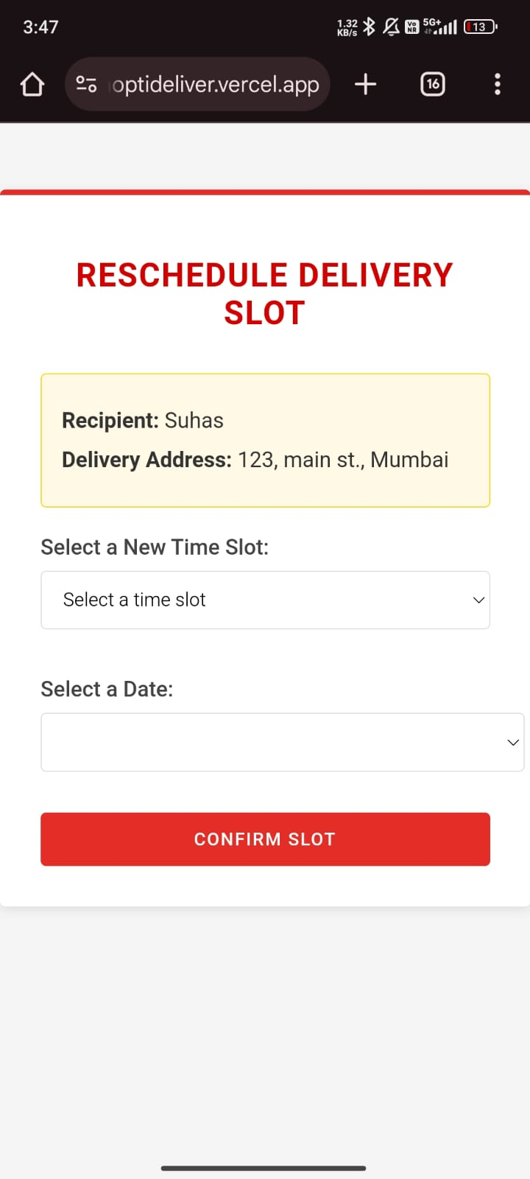
USER INTERFACE - Receiver side
Infinitely Innov@tive

Slide 10
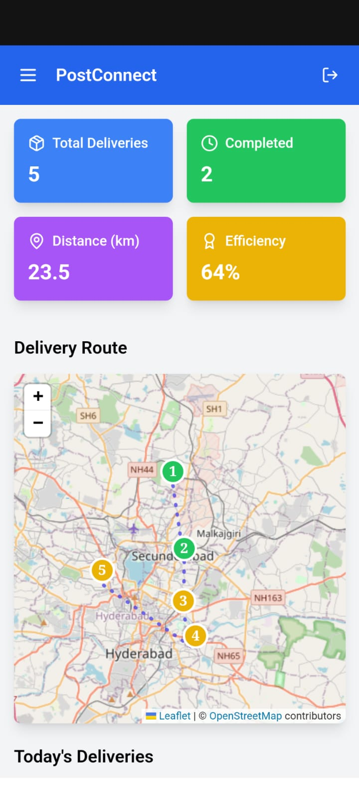
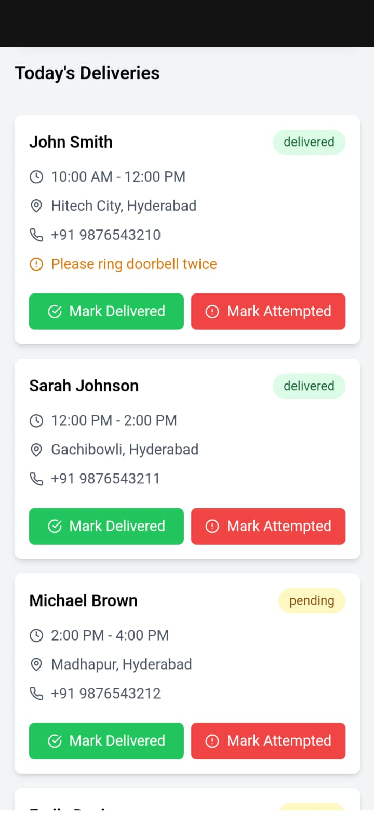
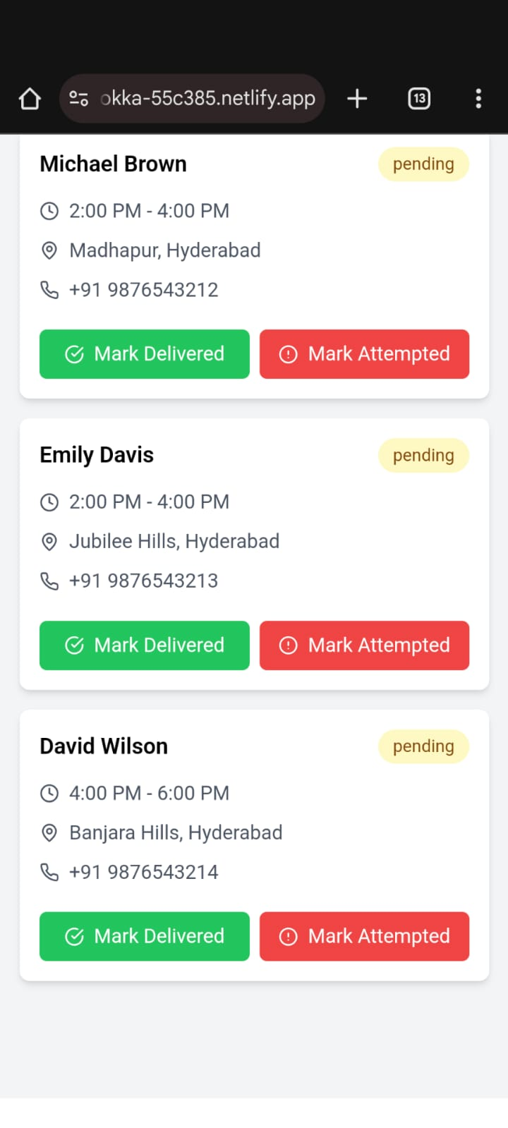
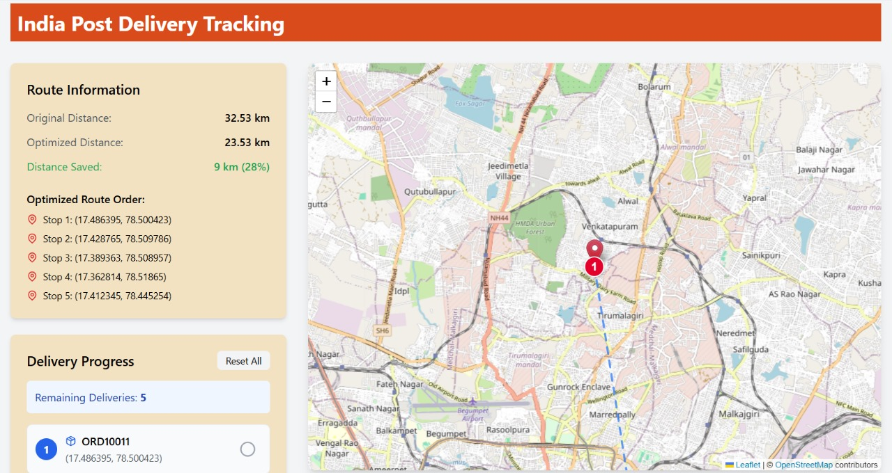
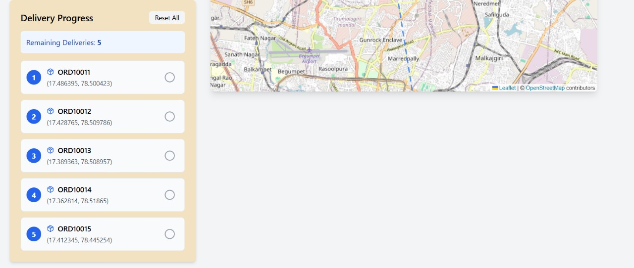
USER INTERFACE - Delivery person
Infinitely Innov@tive

Slide 11
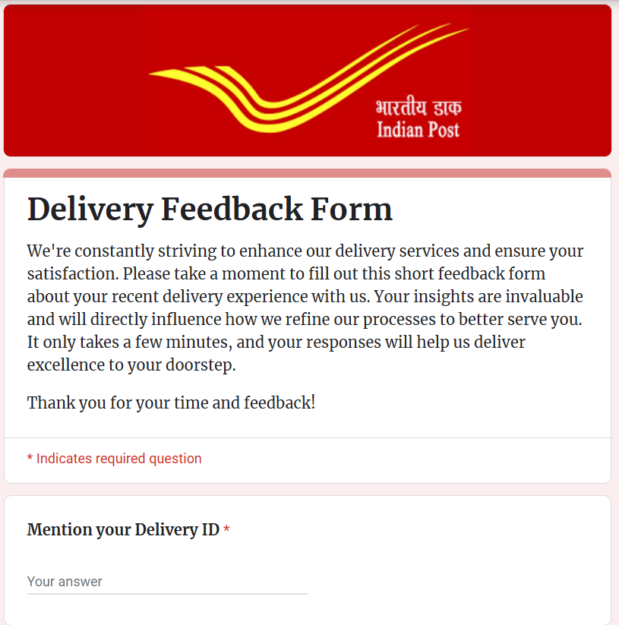
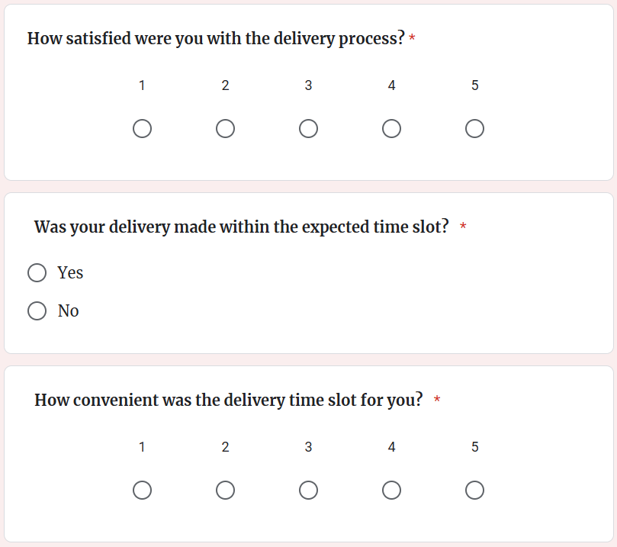
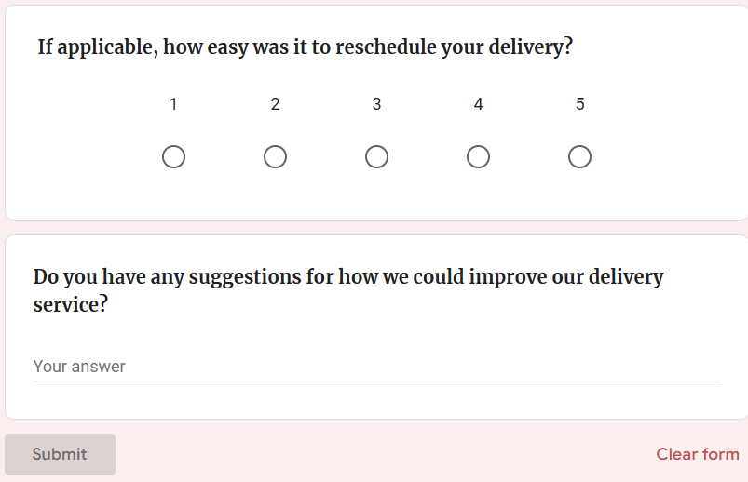
FEEDBACK MECHANISM
Infinitely Innov@tive

Slide 12
FEASIBILITY AND VIABILITY
Infinitely Innov@tive
Feasibility:
Operational: Integration with existing postal systems and workflows
Initial Investment: The costs for system implementation, infrastructure, development, and integration will be assessed.
Long-Term Savings: The potential cost savings and efficiency gains from optimized deliveries will be compared to the initial investment to ensure financial viability.
Potential Challenges & Risks:
Data Quality: Inconsistent or insufficient historical data could impact AI accuracy.
AI Accuracy: Ensuring precise time slot predictions.
User Adoption: Users may need time to adapt to the new system.
Strategies to Overcome Challenges:
Data Collection: Implement data collection mechanisms for improving AI accuracy.
User Training: Provide easy-to-use interfaces and guidance for users.
Pilot Testing: Gradual rollout with feedback loops will allow continuous improvement.

Slide 13
IMPACT AND BENEFITS
Infinitely Innov@tive
Potential Impact on the Target Audience
Customers: Enhanced flexibility and control over delivery times, leading to increased convenience and satisfaction.
Postal Workers: Reduced workload through optimized delivery routes, allowing for more efficient use of time and resources.
Organizations: Improved delivery success rates and customer service metrics, enhancing the overall reputation of the service provider.
Benefits of the Solution
Social: Reduces the need for recipients to alter their daily routines to accommodate delivery schedules.
Economic: Lowers operational costs for delivery services by reducing the number of failed delivery attempts.
Environmental: Optimized delivery routes will reduce fuel consumption and the environmental impact of delivery operations.

Slide 14
REVENUE AND MARKET IMPACT
Infinitely Innov@tive
Cost Reduction: AI predictions could decrease failed delivery attempts by 20%, potentially saving India Post approximately ₹500 crore annually in operational costs.
Enhanced Revenue from Premium Services: Introducing guaranteed time slots as a premium service could significantly boost revenue, especially if even a small percentage of customers opt-in.
Market Expansion: Improved delivery accuracy and customer satisfaction may increase market share by attracting younger customers and retaining existing ones, enhancing overall market penetration by 2-3% per year.
Operational Scalability: Scalable AI technology allows for expansion across regions with minimal additional costs, enhancing return on investment and operational efficiency.
Global SaaS Opportunities: Licensing the AI technology to other logistics entities globally could position India Post as a SaaS leader in the logistics industry.
Sustainability Impact: Optimizing delivery routes reduces carbon emissions, aligning with sustainability goals and potentially attracting environmental grants.
Brand and Competitive Advantage: Adopting advanced AI logistics positions India Post as an innovative leader, strengthening its brand against private competitors and boosting customer loyalty.

